Slide 2
GOVERNMENT RESIDENTIAL WOMEN’S POLYTECHNIC, LATUR
Institute Activities
YEAR 2017-18
Tree plantation
Swach Bharat Abhiyan
Celebrating Jayanties of Indian Patriotic heroes
Programs arranged by Personality Development Cell
Three days Workshop of EDP
Students Mentoring, guiding progamms

Slide 3
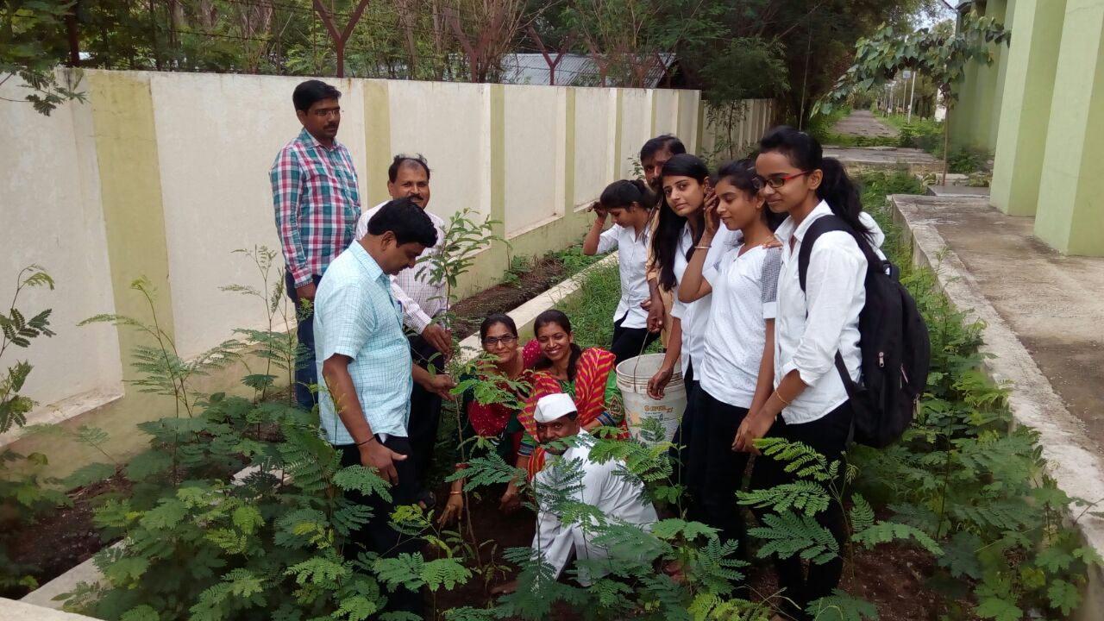
GOVERNMENT RESIDENTIAL WOMEN’S POLYTECHNIC, LATUR
Go Green- Tree Plantation

Slide 4
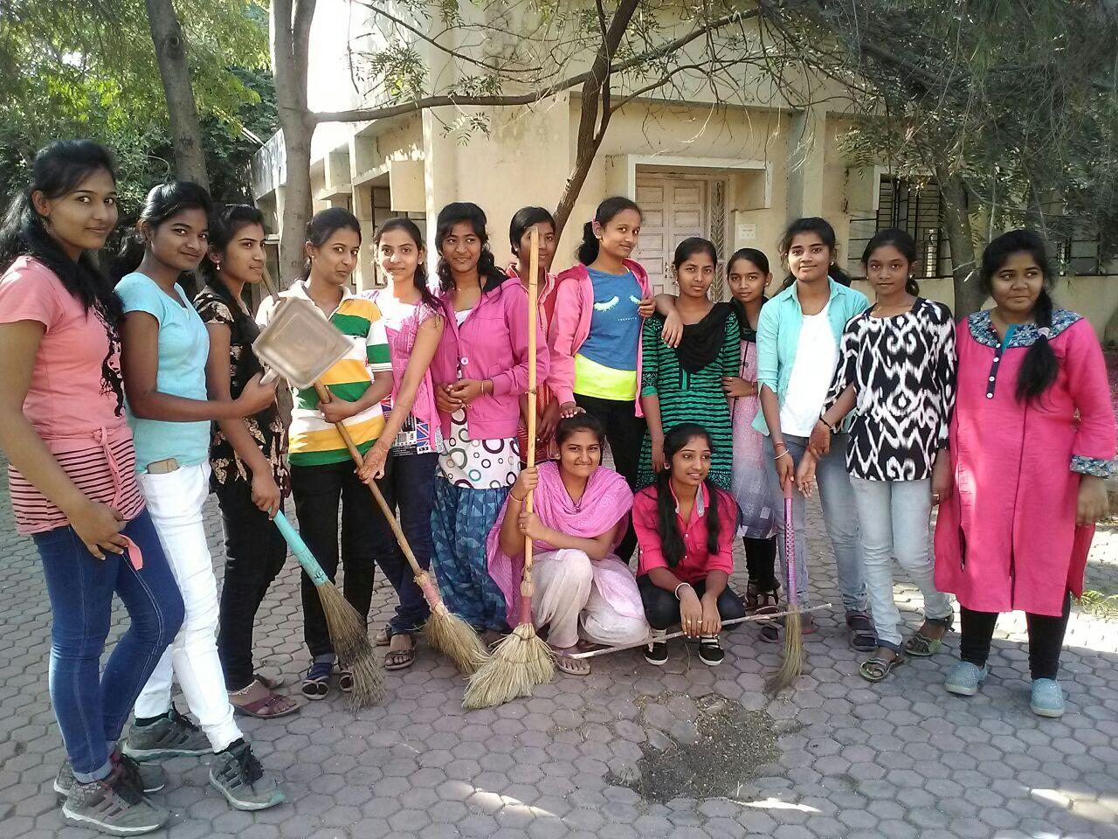
GOVERNMENT RESIDENTIAL WOMEN’S POLYTECHNIC, LATUR
Swach Bharat Abhiyan

Slide 5
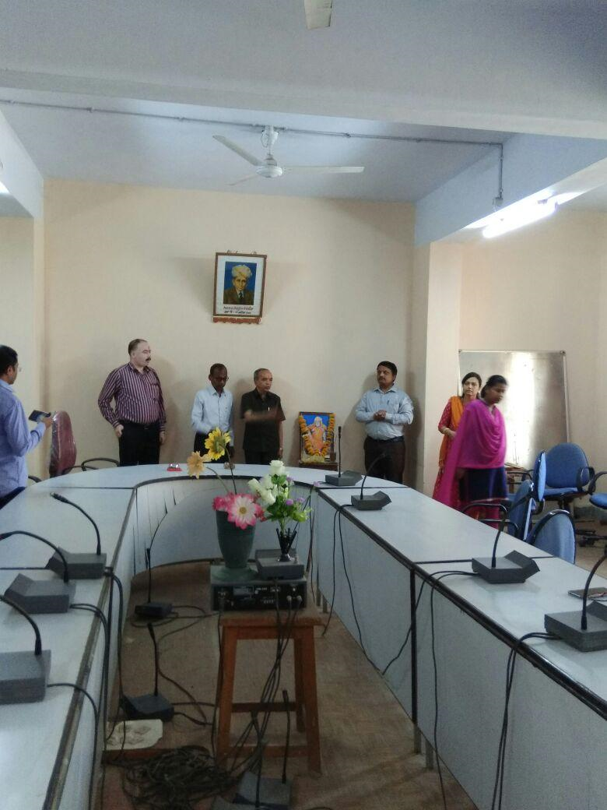
GOVERNMENT RESIDENTIAL WOMEN’S POLYTECHNIC, LATUR
Celebrating Jayanties of Indian Patriotic heroes

Slide 6
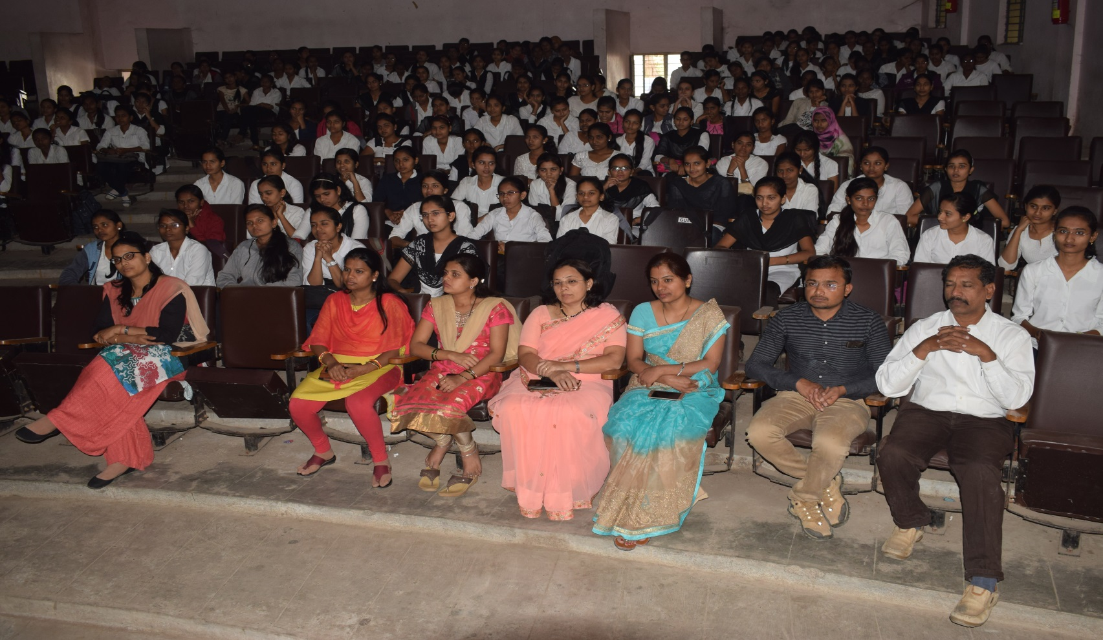
GOVERNMENT RESIDENTIAL WOMEN’S POLYTECHNIC, LATUR
PD Cell- Expert Lecture on “Improving Communication Skill “by Mr. Sachidanad Dhage”

Slide 7
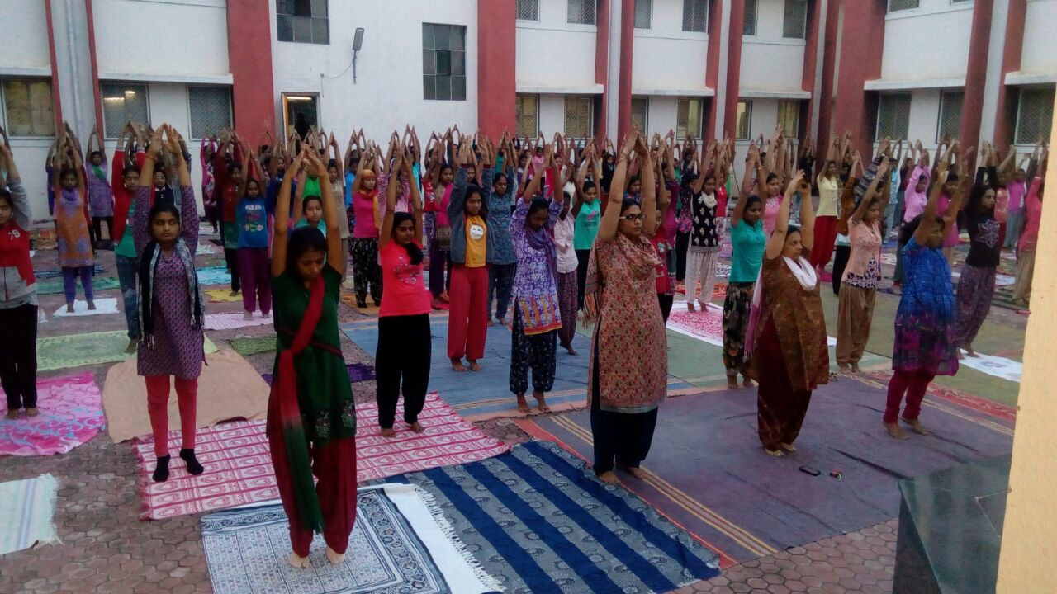
GOVERNMENT RESIDENTIAL WOMEN’S POLYTECHNIC, LATUR
PD Cell -Program Yoga Shibir

Slide 8
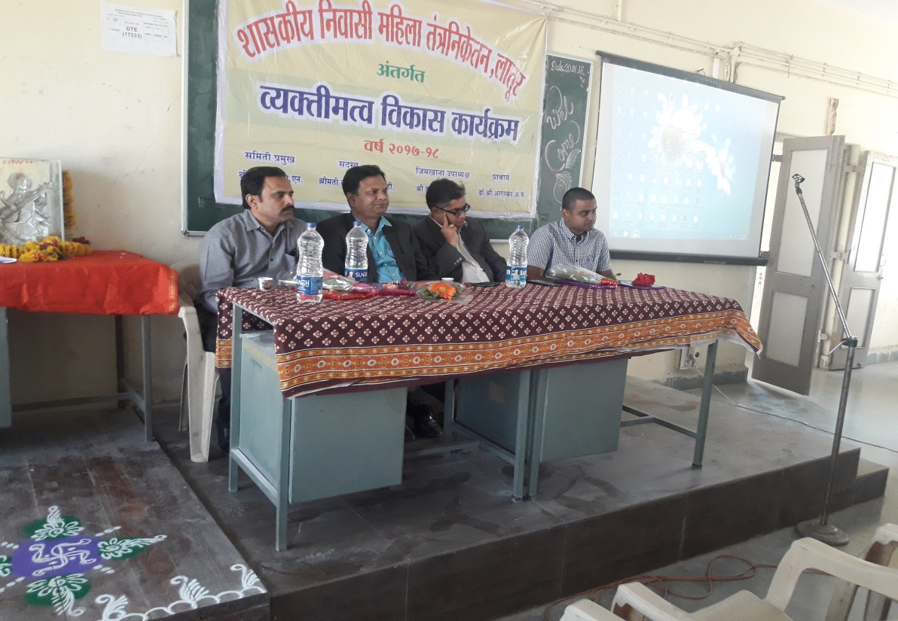
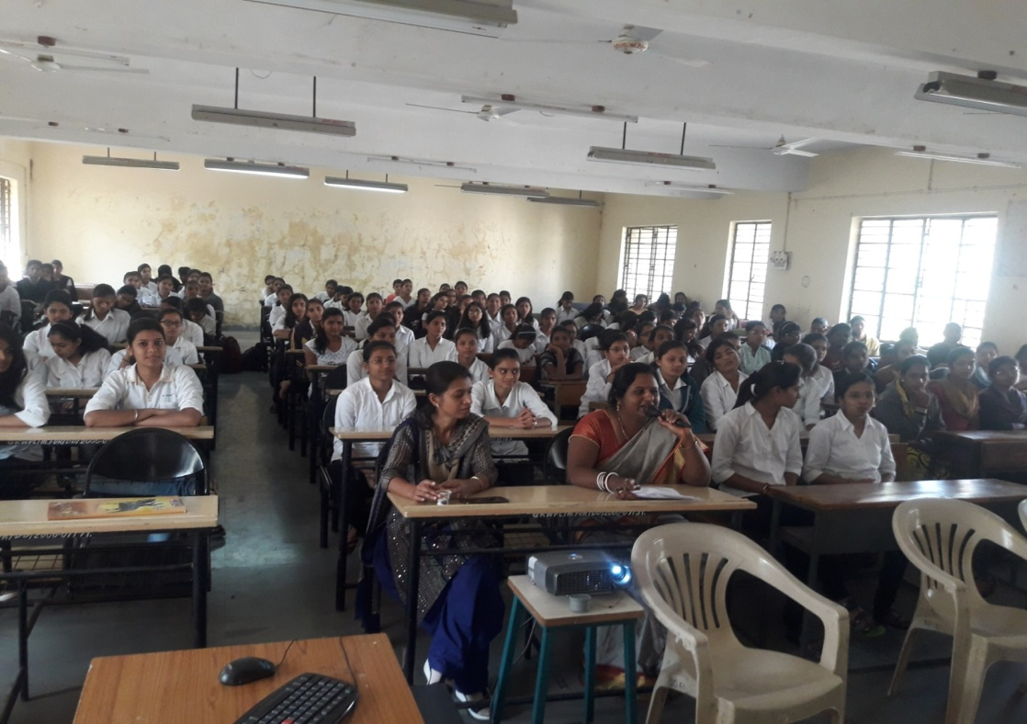
GOVERNMENT RESIDENTIAL WOMEN’S POLYTECHNIC, LATUR
PD Cell- Workshop on ‘Career Planning,’ Seed Management Services, Pune.

Slide 9
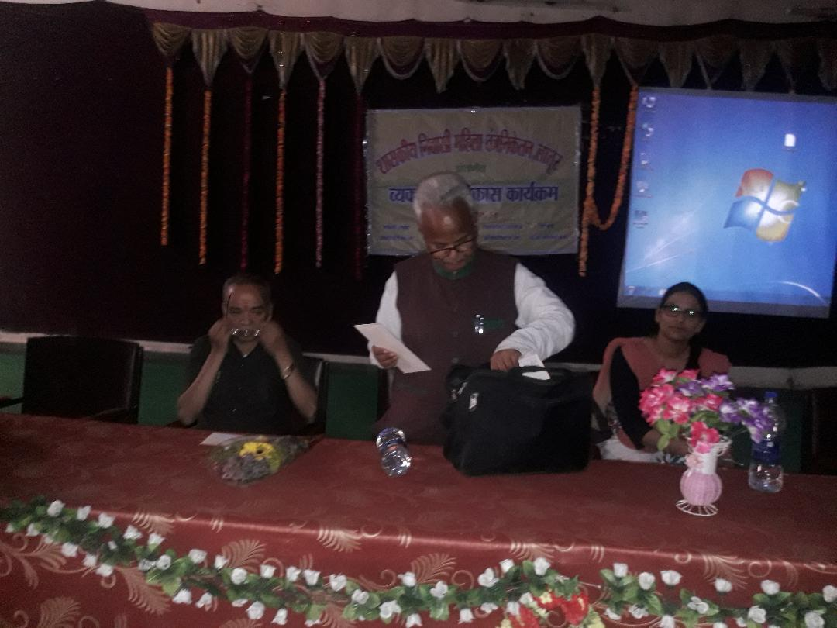
GOVERNMENT RESIDENTIAL WOMEN’S POLYTECHNIC, LATUR
PD Cell Expert Lecture on “Carrer Opportunities” by Dr. S.G. Kahalekar

Slide 10
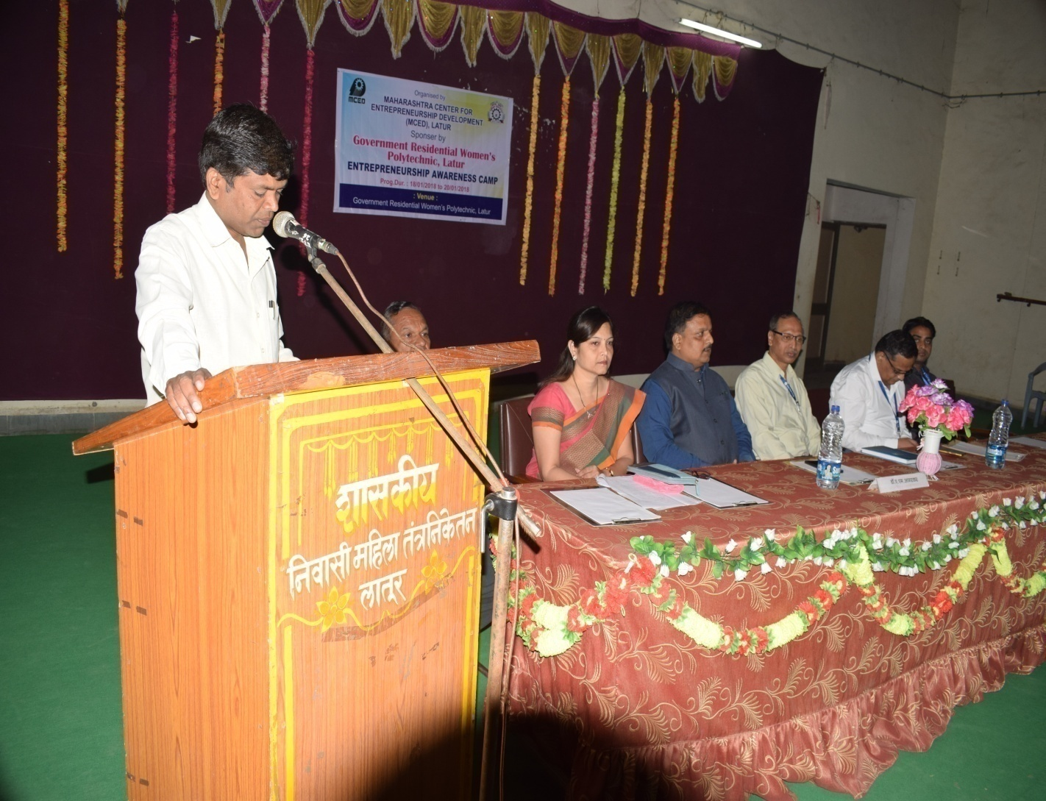

GOVERNMENT RESIDENTIAL WOMEN’S POLYTECHNIC, LATUR
Three days EDP Programme

Slide 11
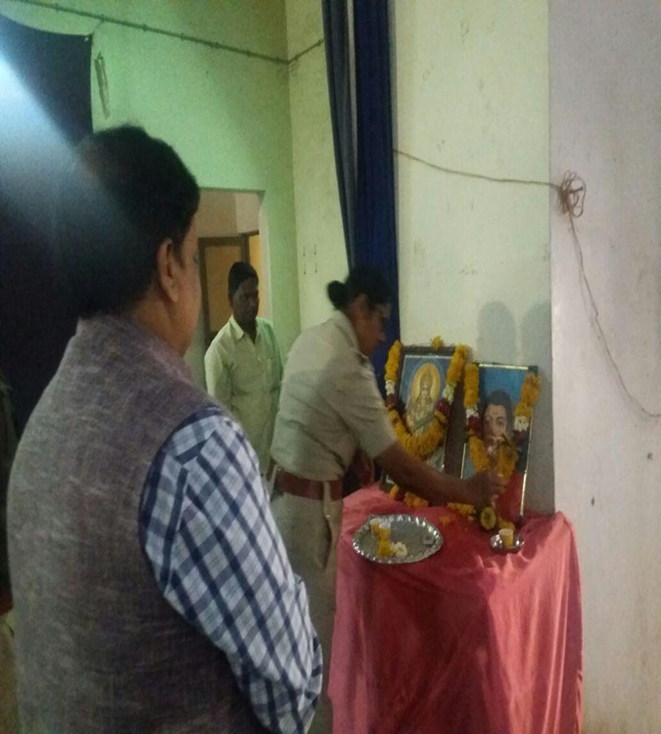
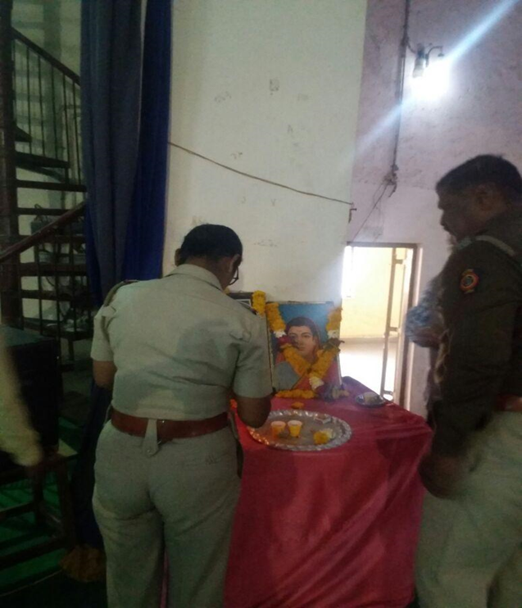
GOVERNMENT RESIDENTIAL WOMEN’S POLYTECHNIC, LATUR
Police Raising Day

Slide 12
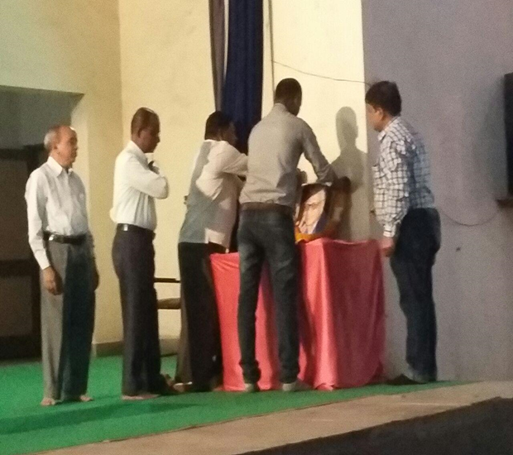
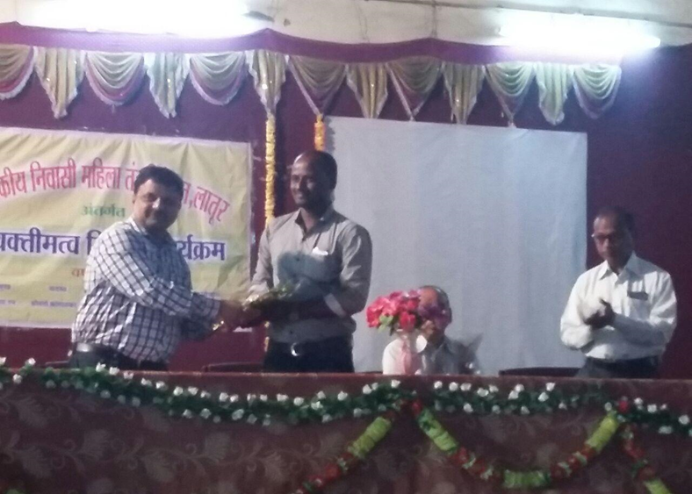
GOVERNMENT RESIDENTIAL WOMEN’S POLYTECHNIC, LATUR
Marathi Bhasha Gaurav Din

Slide 13
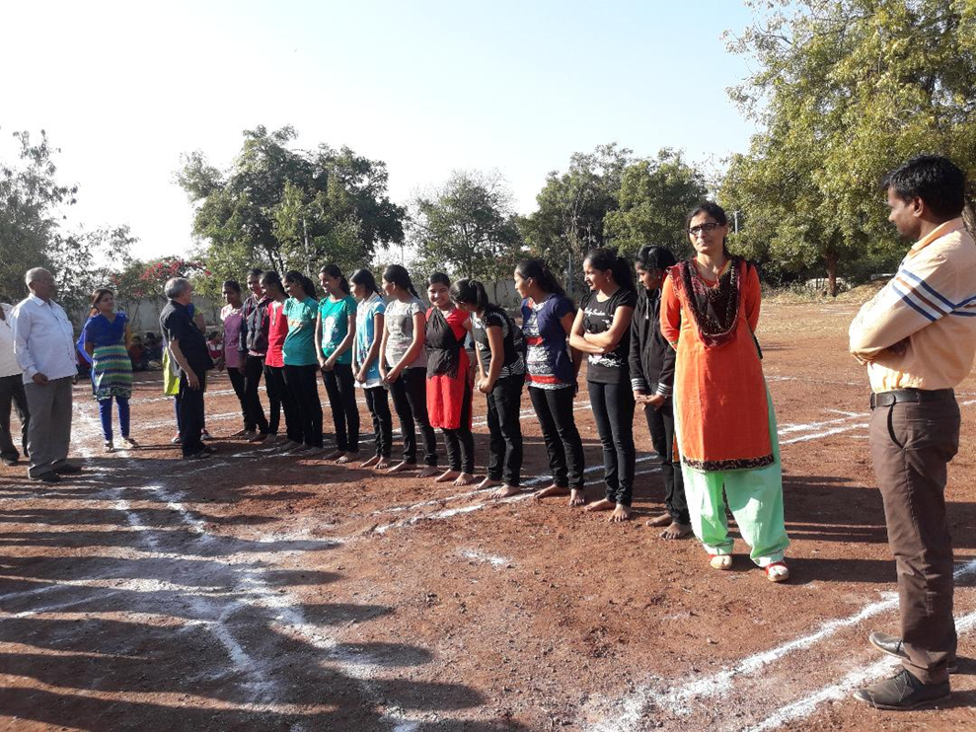
GOVERNMENT RESIDENTIAL WOMEN’S POLYTECHNIC, LATUR
Inter College Sports-

Slide 14
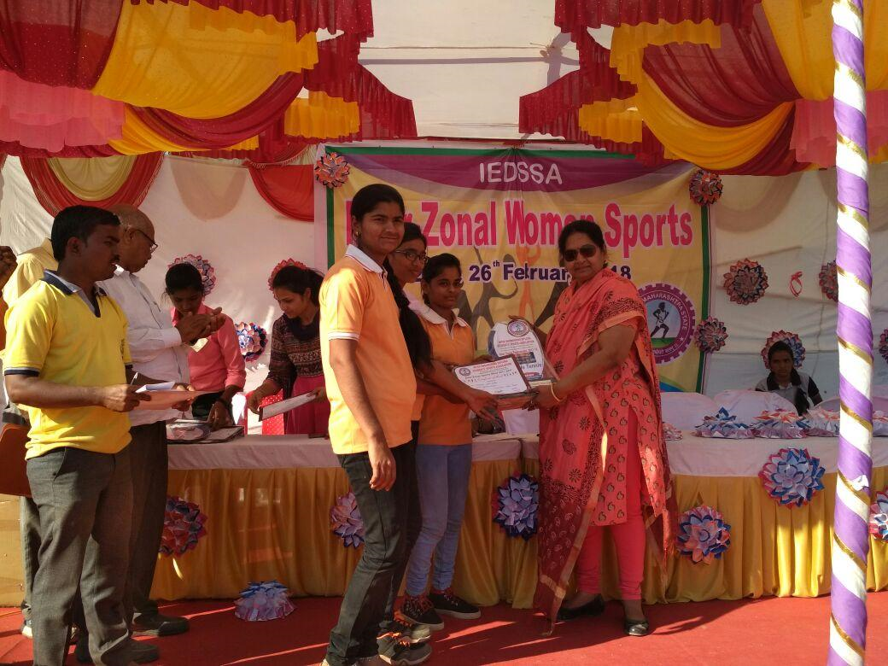
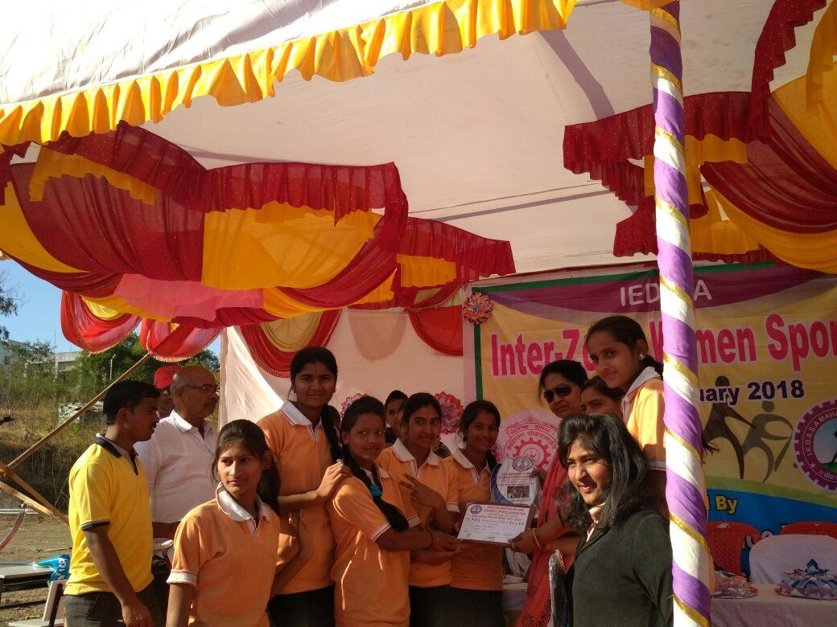
GOVERNMENT RESIDENTIAL WOMEN’S POLYTECHNIC, LATUR
WINNERS in IDESSA IN G.R.W.P. TASGAON JAN-2018

Slide 15
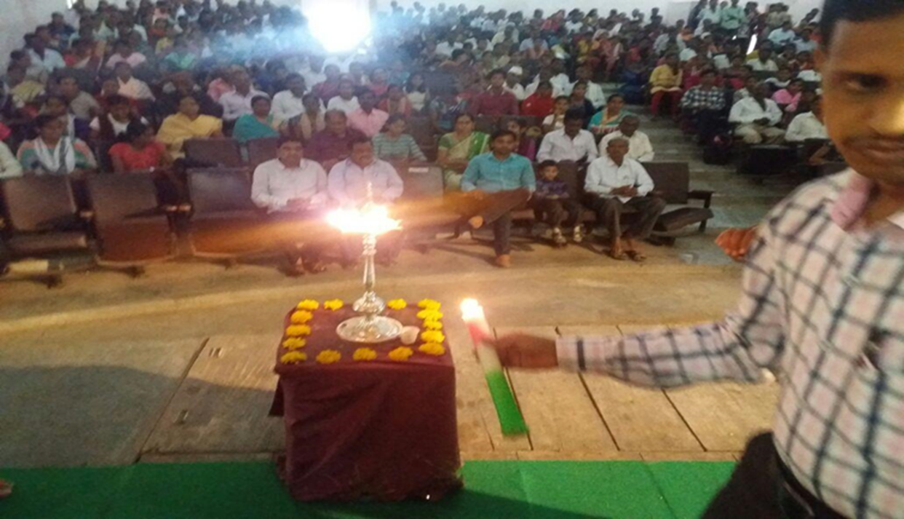
GOVERNMENT RESIDENTIAL WOMEN’S POLYTECHNIC, LATUR
Parents Meet

Slide 16
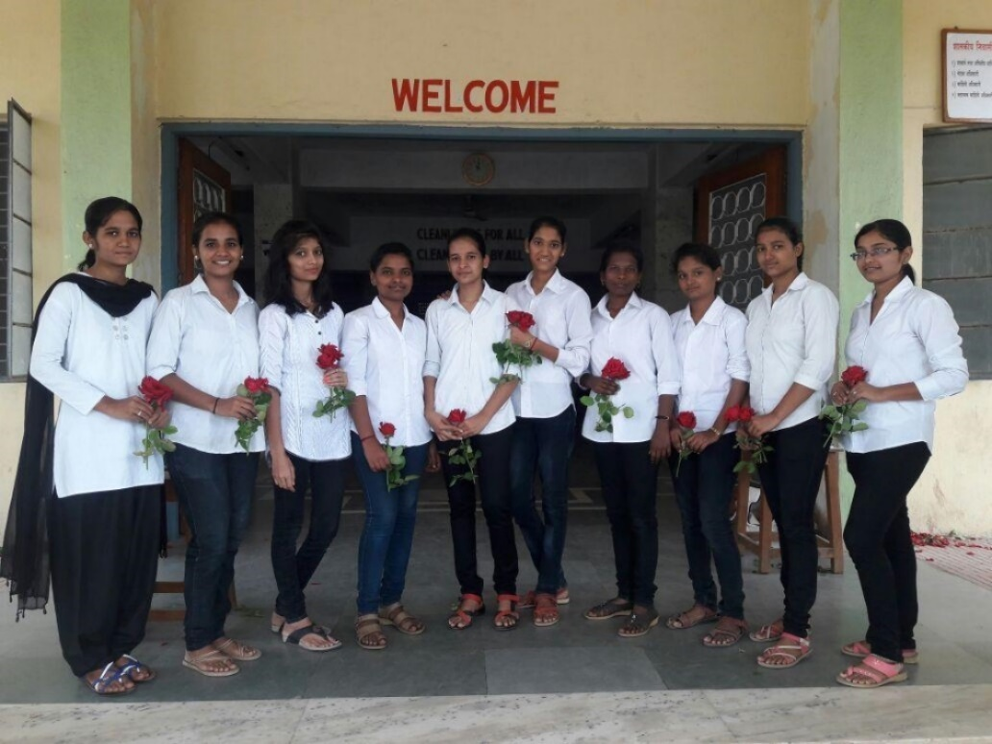
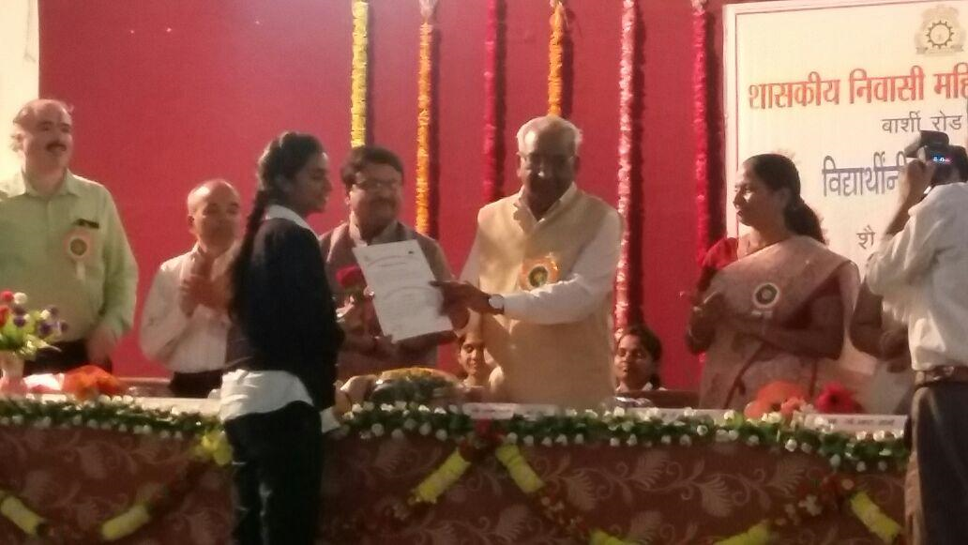
GOVERNMENT RESIDENTIAL WOMEN’S POLYTECHNIC, LATUR
Vidhyarthi Sansad

Slide 17
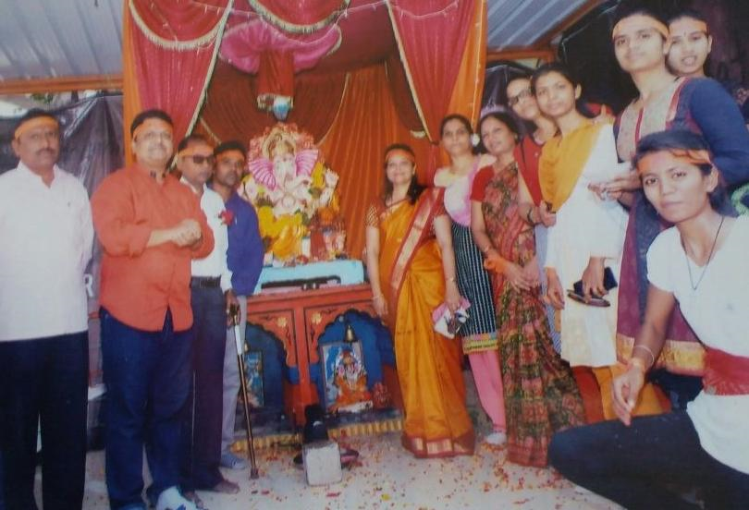
GOVERNMENT RESIDENTIAL WOMEN’S POLYTECHNIC, LATUR
Ganesh Festival

Slide 18
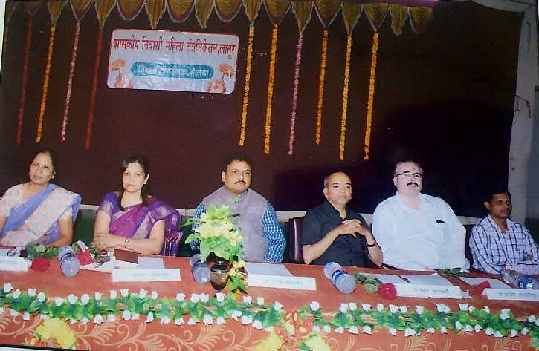
GOVERNMENT RESIDENTIAL WOMEN’S POLYTECHNIC, LATUR
Teacher’s Day Celebration

Slide 19
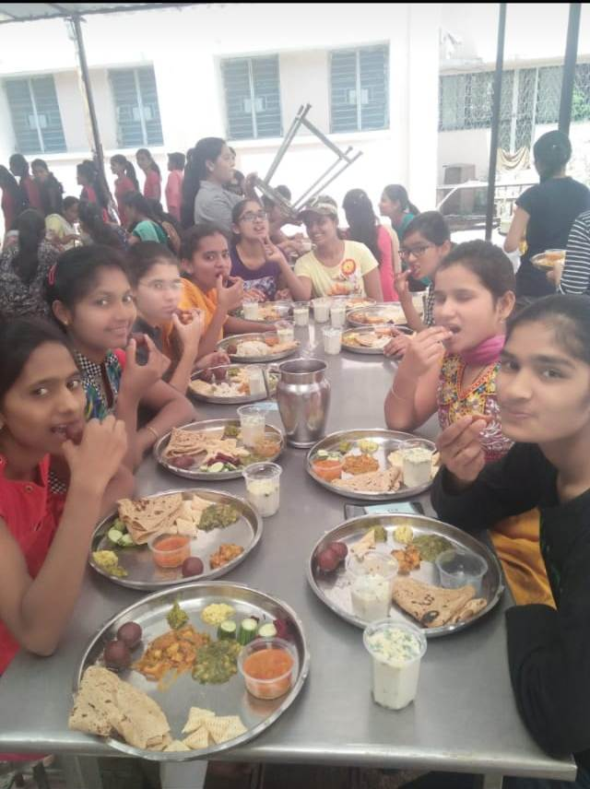
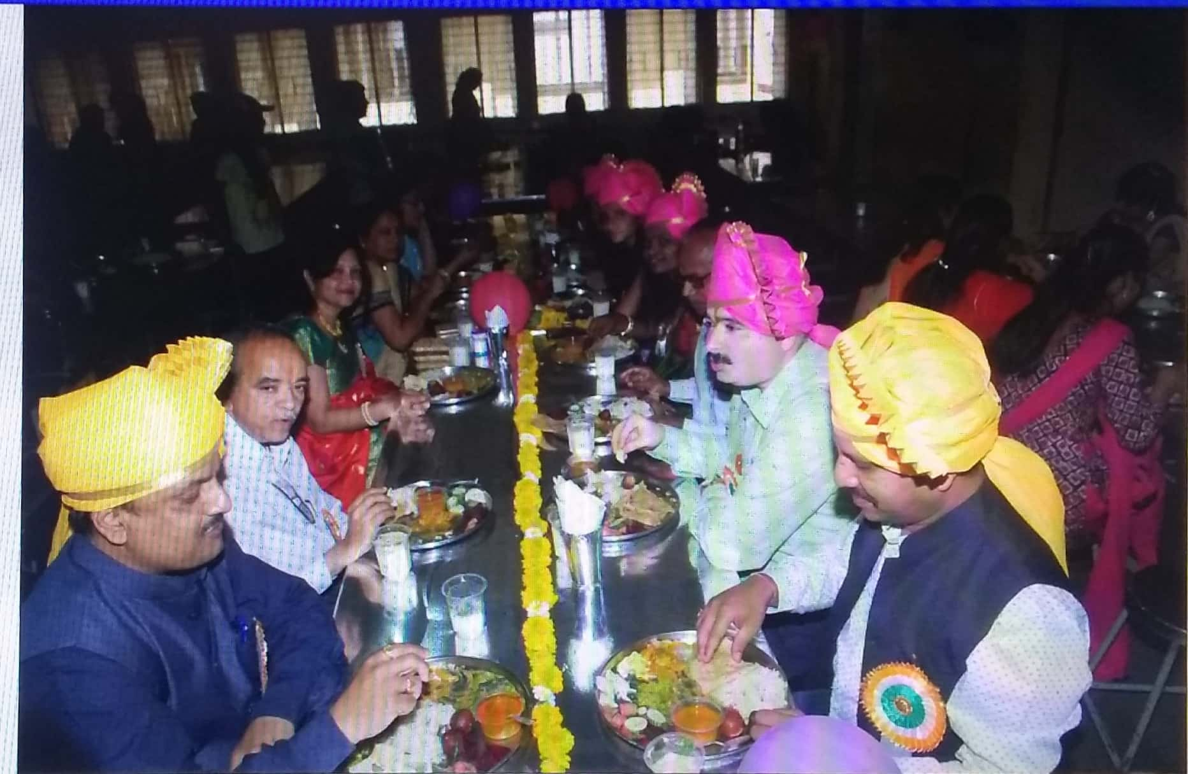
CO OPERATIVE MESS RUN BY STUDENTS

Slide 20
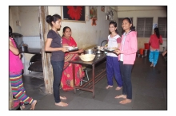
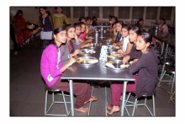
CO OPERATIVE MESS RUN BY STUDENTS

Slide 21
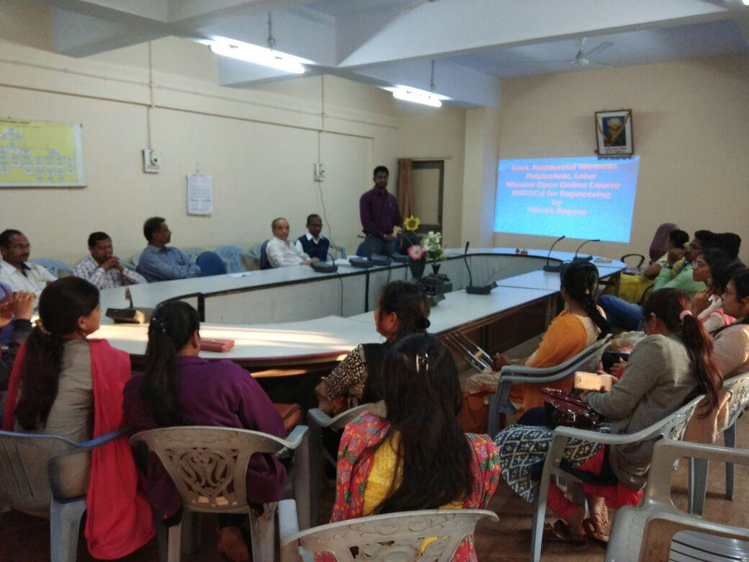
GOVERNMENT RESIDENTIAL WOMEN’S POLYTECHNIC, LATUR
Expert Lecture on MOOCS

Slide 22
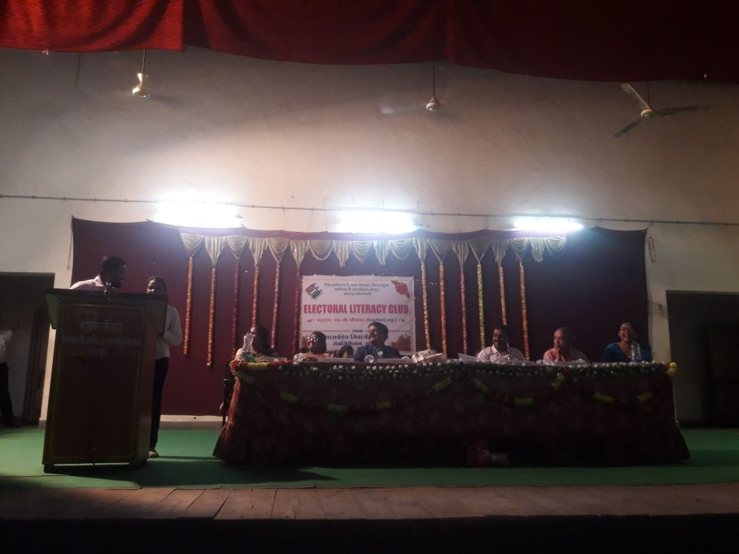
GOVERNMENT RESIDENTIAL WOMEN’S POLYTECHNIC, LATUR
Mahila Jagruti

Slide 23
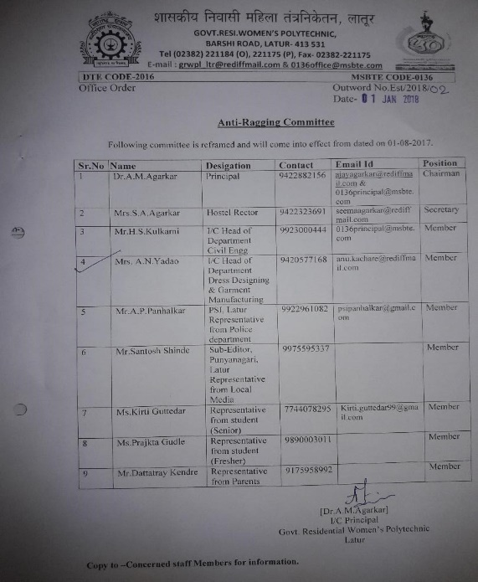
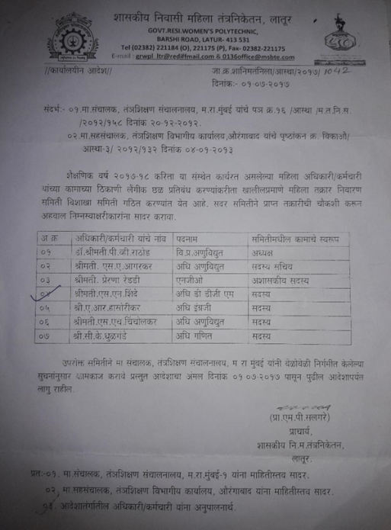
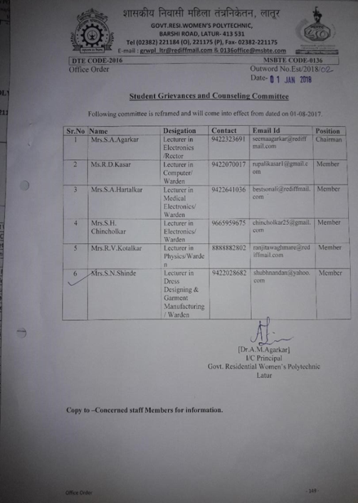
GOVERNMENT RESIDENTIAL WOMEN’S POLYTECHNIC, LATUR
Committees for student’s welfare-
Anti Ragging Committee
Anti –Harassment Committee/ Women’s Grievance Committee
Student’s Mentoring Committee

Slide 24
GOVERNMENT RESIDENTIAL WOMEN’S POLYTECHNIC, LATUR
Institute conducts all activities carried out by
MSBTE and DTE
Admission Reporting Centre (ARC)
Facility Center for admission (FC)
Distribution Centre (DC)
Regional Assessment Center (ARC)

Slide 25
GOVERNMENT RESIDENTIAL WOMEN’S POLYTECHNIC, LATUR
THANK YOU

